Slide 1

UNEMPLOYMENT

Slide 2

UNEMPLOYMENT
people who are willing and able to work but do not have a job.
it affects income, productivity, living standards and economic growth.
Notes:
Timing: 20–30 seconds. Animation: Fade title, then bullets one-by-one. Transition: Fade. Optional sound: soft instrumental only if required.

Slide 3
WHAT IS UNEMPLOYMENT?
Key idea
Labour force = employed + unemployed people seeking/available for work.
Unemployment rate measures unemployed people as a share of the Labour force.
Unemployment occurs when people in the Labour force are without work and are available for and seeking work.
Main forms: frictional, structural, cyclical and seasonal unemployment.
A low unemployment rate does not automatically mean every available worker has a good or secure job.
Notes:
Timing: 45–60 seconds. Animation: Appear bullets one-by-one. Transition: Push. Hyperlink suggestion: link the phrase 'ILO definition' to the ILO page.

Slide 4
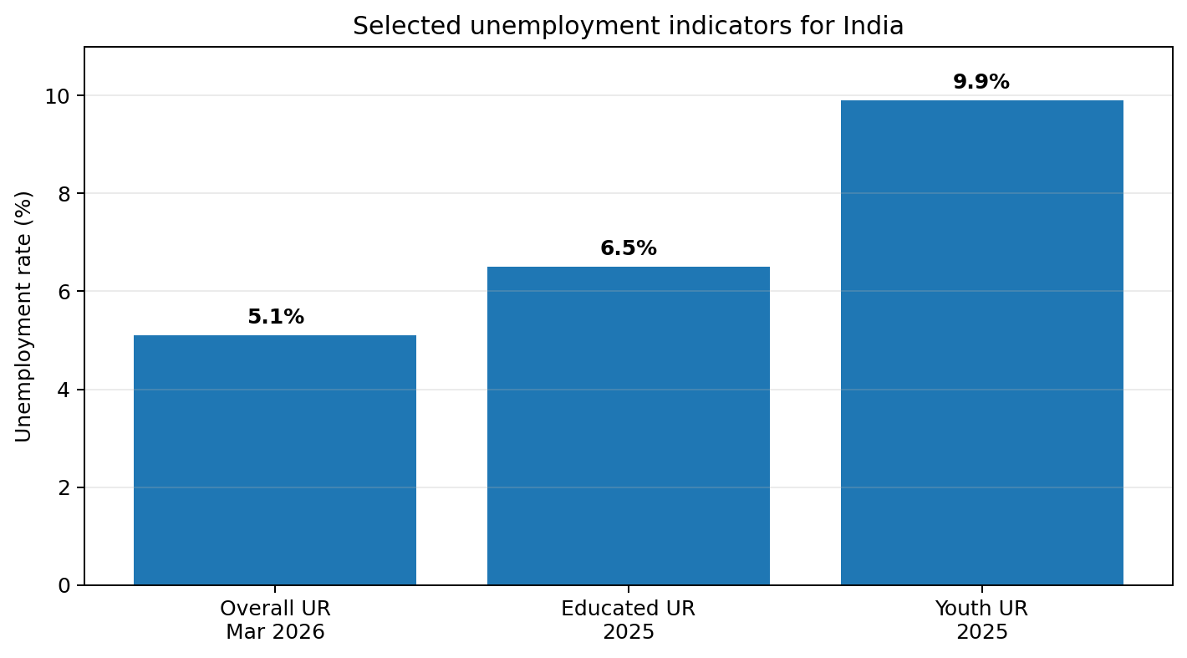
INDIA: SELECTED DATA
Indicator | Year / period | Rate
Overall unemployment | Mar 2026 | 5.1%
Educated (secondary+) | 2025 | 6.5%
Youth (15–29) | 2025 | 9.9%
Source: Government of India, MoSPI / PLFS 2025 and March 2026 bulletin.

Slide 5
CAUSES AND EFFECTS
CAUSES
EFFECTS
Skill mismatch
Slow job creation
Economic slowdown
Seasonal work
Technology & structural change
Lower household income
Higher poverty risk
Loss of skills/productivity
Social stress
Slower inclusive growth
Notes:
Timing: 50–60 seconds. Animation: two cards fly in from opposite sides. Transition: Split.

Slide 6
SOLUTIONS & KEY TAKEAWAYS
REMEMBER
✓ Skills
✓ Investment
✓ Entrepreneurship
✓ Job matching
✓ Decent work
Expand practical education, apprenticeships and industry-linked skills.
Support MSMEs, entrepreneurship and investment that create productive jobs.
Improve job matching, career guidance and access to labour-market information.
Promote formal, safe and productive employment alongside job creation.
Conclusion: reducing unemployment requires both more jobs and better alignment between skills and opportunities.
https://en.wikipedia.org/wiki/Unemployment
Notes:
Timing: 45–60 seconds. Animation: bullets appear one-by-one; final takeaway zoom/fade. Transition: Fade. Hyperlink suggestion: MoSPI PLFS page.

Slide 7
Thank you…

